Slide 1

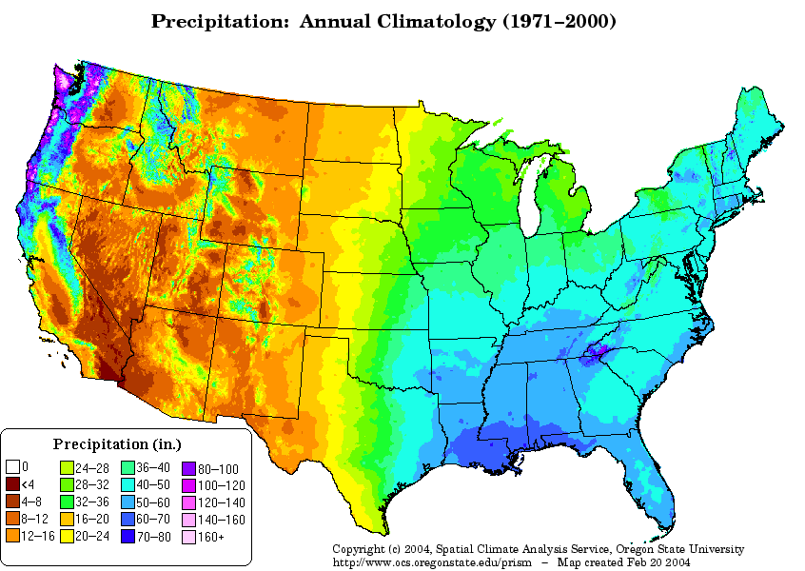
Extreme Weather Impacts on Water and Wastewater Utilities
December 11, 2012
Presented by:
Bret M. Casey, P.E., BCEE

Slide 2
Objectives for Today’s Presentation
Focus on impacts to drinking water – however extreme weather can significantly impact wastewater treatment facilities
Identify weather events that impact:
  Disinfection byproduct formation and treatment
  Microbial events or concerns
Provide data/case studies where such effects were documented
Demonstrate the use of WaterQIEWE

Slide 3
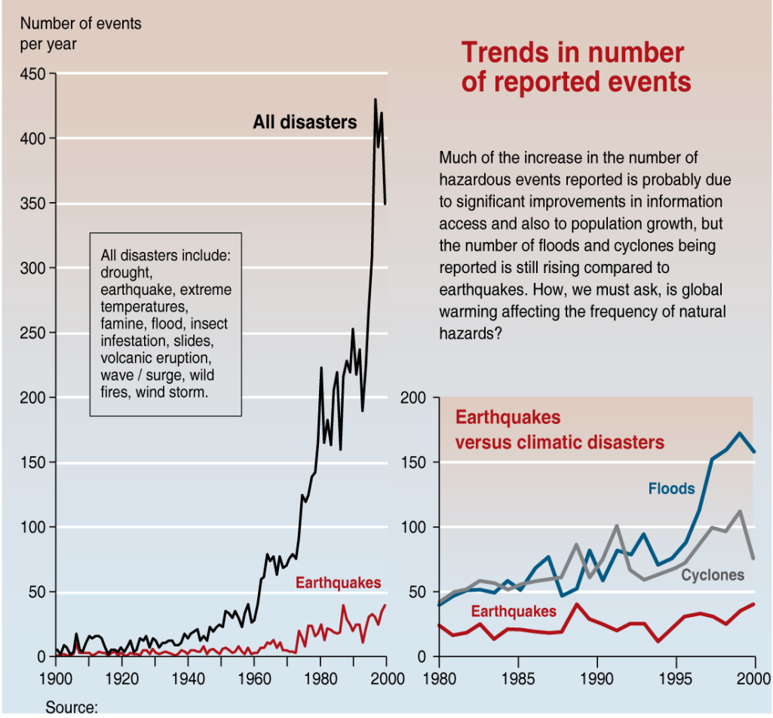
Increasing Frequency and Intensity of Extreme Weather Events
Peduzzi, 2004
Notes:
Some of the causes of this change is a combination of more people (factor of 4 increase since 1900) and better reporting (e.g. satellites).
More people means more infrastructure to be damaged and more people affected in the event of an water supply emergency.

Slide 4
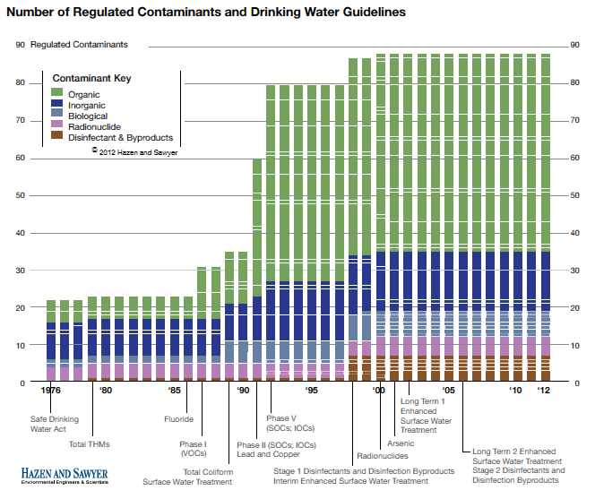
Notes:
Unlike just 20 or 30 years ago, utilities currently have a much more stringent regulatory burden, which may become more so in the future.
In order to meet numerous requirements, not only for water quality regs, but also for recreation, environmental services, and other stakeholder needs. Our drinking water systems have become increasingly complex. Unfortunately that complexity often opens up utilities to being more sensitive to variations from normal.

Slide 5
2010 to 2012: Years of Extremes

Slide 6
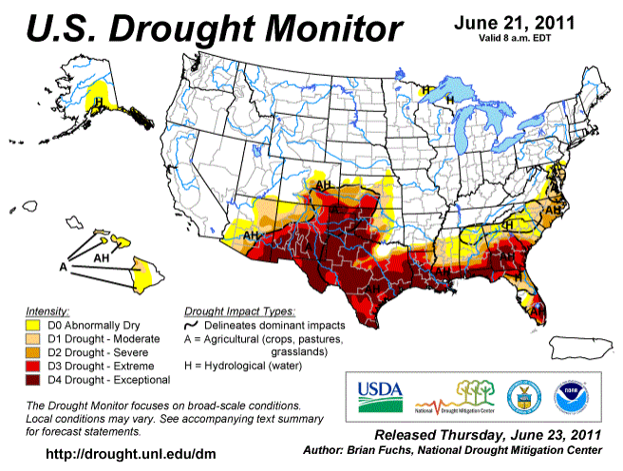
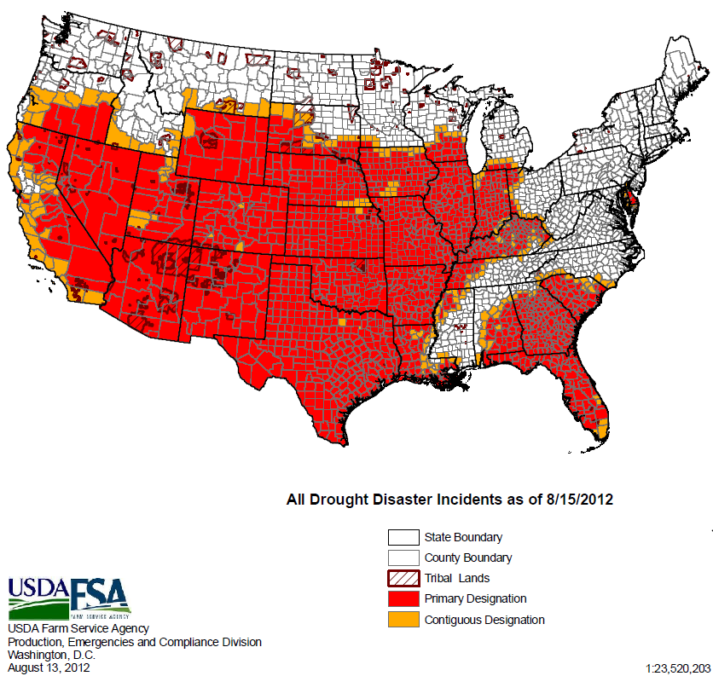
Droughts and Extreme Heat
2012: 63% of the continental U.S. affected by drought
8/11 to 7/12: Warmest 12 month period ever recorded
June 2012 heat wave: thousands of records broken
2011: Texas drought

Slide 7
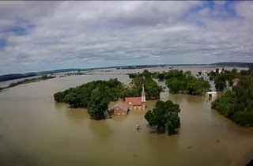
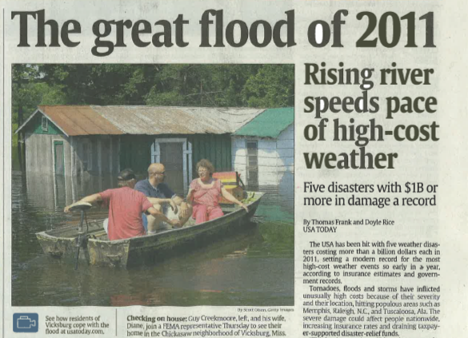
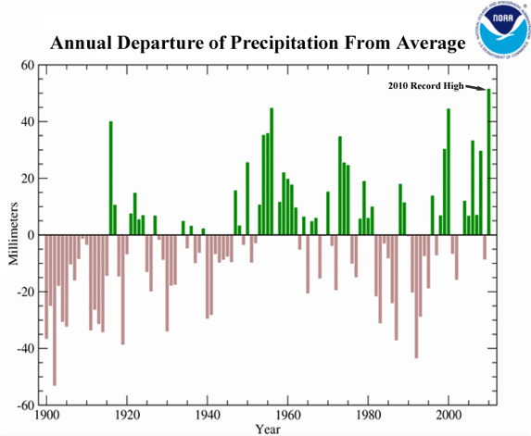
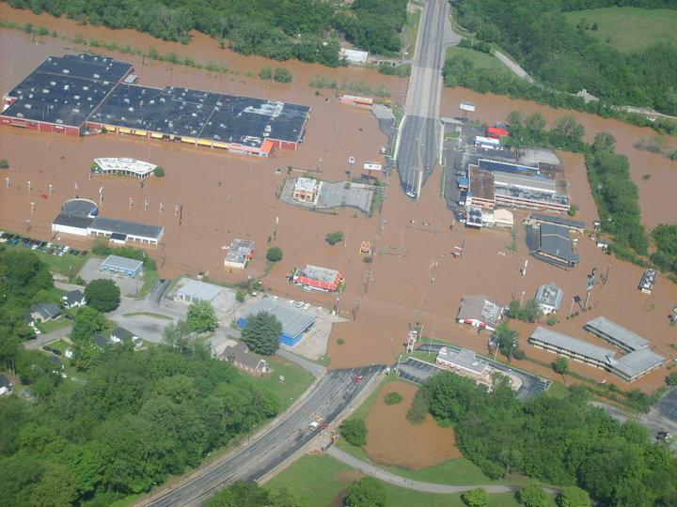
Historic Floods
2011 Missouri flood
2011 Mississippi flood
2010 wettest year over land
2010 Tennessee's 1000 year flood kills 30, does $2.4 billion in damage
Notes:
With droughts come wildfires, 2010 and 2011 have been above average wildfire years

Slide 8
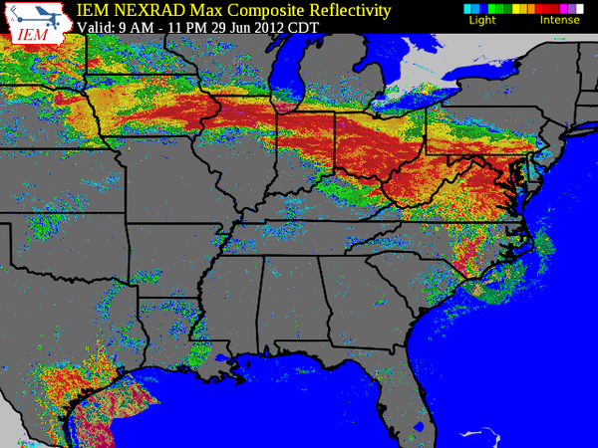
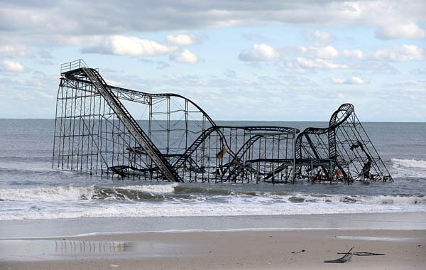
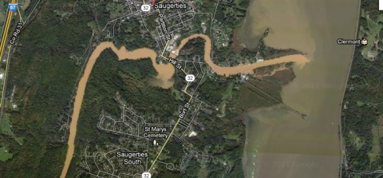
Extreme Storms
Hurricanes Sandy, Isaac, Irene; Tropical Storm Lee
2012 derecho – 3.4 million people lost power
2011 record year for tornados
Notes:
Rollercoaster from Sandy, turbid stream is from the aftermath of Hurricane Irene and tropical storm Lee in the NYC watershed.
Weather map is from the derecho - widespread, long-lived wind storm that is associated with a band of rapidly moving showers or thunderstorms. Although a derecho can produce destruction similar to that of tornadoes, the damage typically is directed in one direction along a relatively straight swath. As a result, the term "straight-line wind damage" sometimes is used to describe derecho damage. By definition, if the wind damage swath extends more than 240 miles (about 400 kilometers) and includes wind gusts of at least 58 mph (93 km/h) or greater along most of its length, then the event may be classified as a derecho.

Slide 9
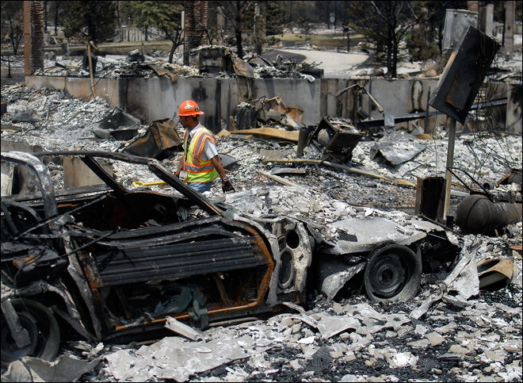
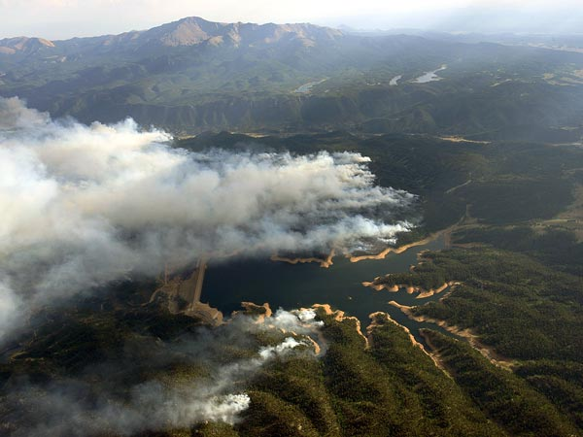
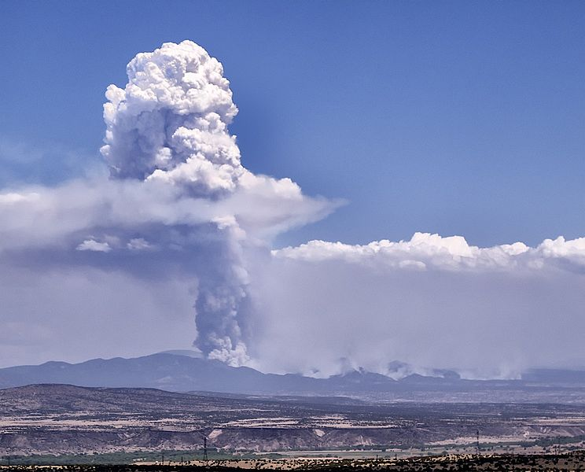
Wildfires
Record-breaking wildfires in AZ, CA, CO, ID, NM, OR, MT, and TX

Slide 10
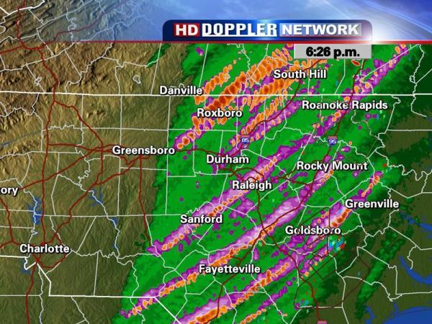
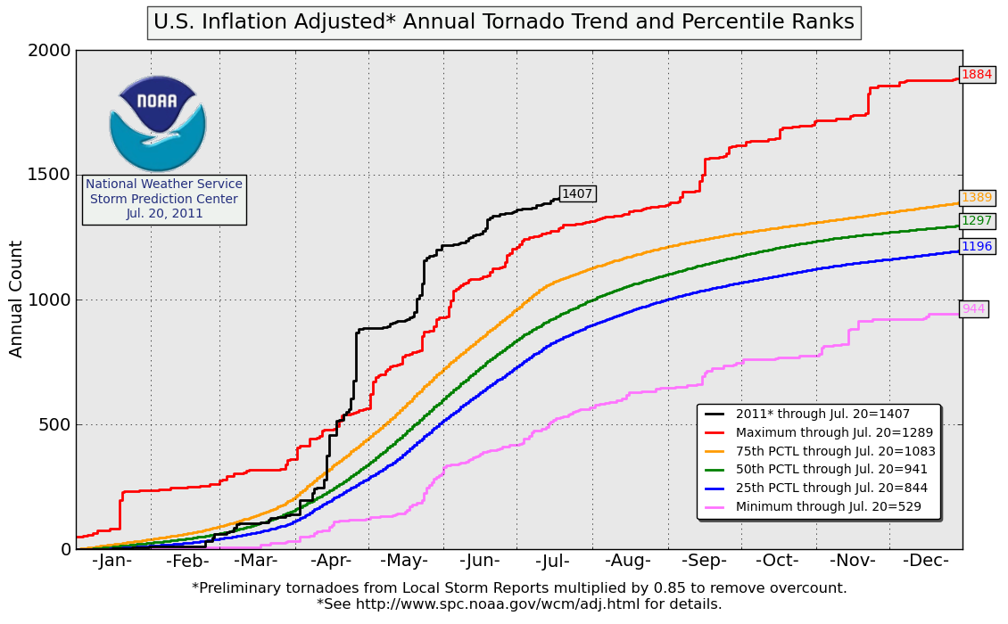
Tornados
WRAL TV, Raleigh
Notes:
Extremely deadly and damaging storms.
Black line on chart shows that the number of tornadoes in 2011 were far above the Maximum. The total for 2011 ended up being ~1900 tornadoes
Other extremes included snowstorms and hurricanes

Slide 11
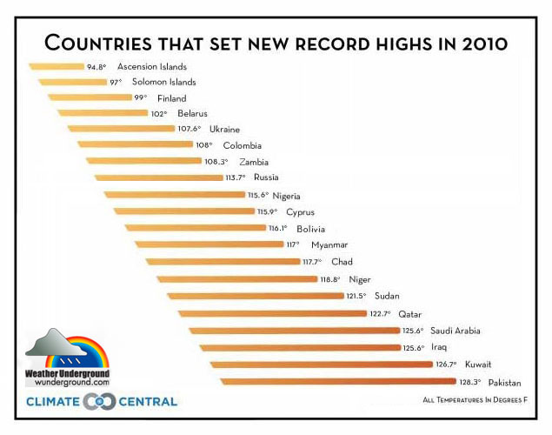
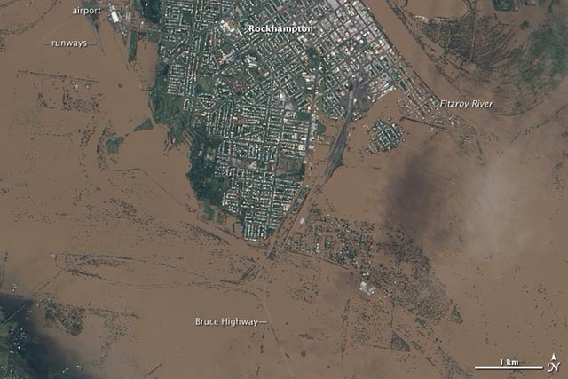
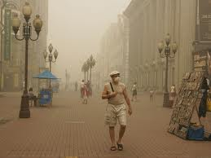
Extreme Weather Internationally
Notes:
Figure 17. The airport, the Bruce Highway, and large swaths of Rockhampton, Australia, went under water due to flooding from the Fitzroy River on January 9, 2011. The town of 75,000 was completely cut off by road and rail, and food, water and medicine had to be brought in by boat and helicopter. Image credit: NASA.
Pakistani and Australian Floods in
European Heat Wave and resulting wildfires
Amazon rainforest experiences its 2nd 100-year drought in 5 years
2010 was tied for the hottest year on record and 20 countries broke high temperature records

Slide 12
How do we define extreme event?
Event that negatively impacts a utility
Largely defined by utilities themselves, subjective
Avoiding use of quantitative statistics
  Vary be region and locality specific
  May exclude minor
  weather variations
  that result in impacts
Notes:
Given the wide geographic distribution of utilities for this project, what is extreme for one utility (e.g., only 2 – 4 inches of rain falling in a year in Raleigh, NC) may be normal for another utility (e.g., 2 – 4 inches of rain per year in Las Vegas, NV).
Whether or not the event would be classified as “extreme” by a percentile measurement does not change the impact that was observed by the utility. In other words, water treatment facilities are designed to handle perturbations to the system; any external (i.e. weather) events that stress or exceed the ability of the system to handle those perturbations could subjectively be called “extreme” and is by nature worth noting in the context of this project.

Slide 13
Impacts on Water Demands

Slide 14
Future Projections Indicate Increased Variability in Water Supply and Demand
Colorado Springs Example from Water Research Foundation Project 4263
“Analysis of Changes in Water Use under Regional Climate Change Scenarios
Incorporates both climate change and demand modeling
Developing Models for multiple locations to develop guidelines for future water demand forecasting

Slide 15
Estimated Baseline

Slide 16
Estimated Baseline and Historical Variability

Slide 17
2090 Mean “Cooler/Drier”

Slide 18
2090 Mean “Warmer/Wetter”

Slide 19
2090 Mean “Warmer/Drier”

Slide 20
2090 Mean and Variability “Warmer/Drier”

Slide 21
Case Studies of Impacts on Reservoir Water Quality

Slide 22
WaterRF 4324: Water Quality Impacts of Extreme Weather-Related Events Database
Existing database of 45 case studies at the time of preparing this presentation
Coverage includes Australia and US
Literature sources also included in report
Published Fall 2013
Article published in January issue of OpFlow

Slide 23
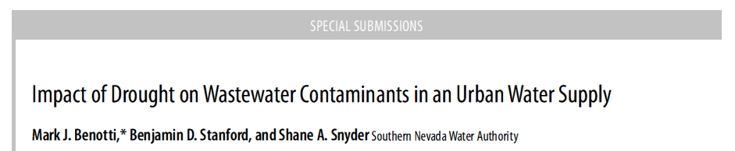
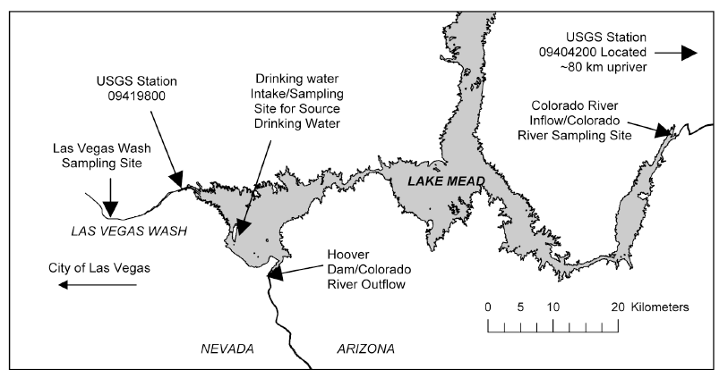
Journal of Environmental Quality, July 2010

Slide 24
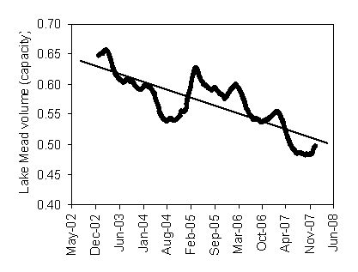
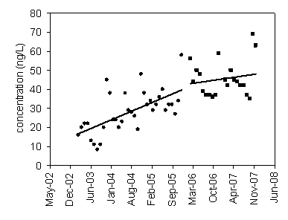
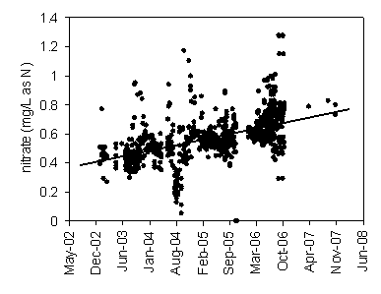
slope 1 = 0.02
p < 0.0001
slope = -0.00007
p < 0.0001
slope = 0.0002
p < 0.0001
slope 2 = 0.008
p = 0.004
Journal of Environmental Quality, July 2010

Slide 25
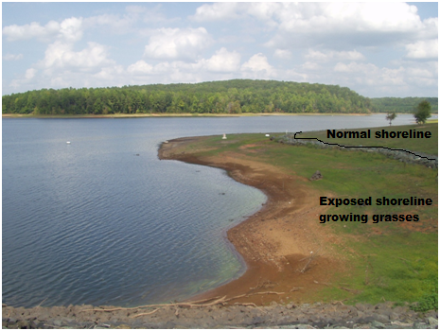
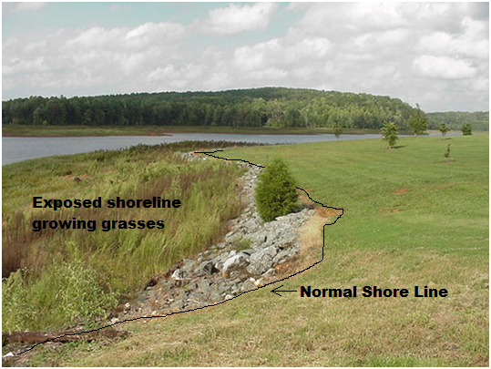
Utility 2: DBPs from Droughts of 2002 and 2007

Slide 26
DBPs Increase ~1 Year after Drought & Refill

Slide 27
Utility 2: Impacts & Lessons
Public notification required for exceedances
Increased calls/concern from the public
Powdered activated carbon used to minimize further impacts
Increased DBP sampling performed
Recommended clearing grasses, brush, and debris that accumulate along reservoir edge during drought

Slide 28
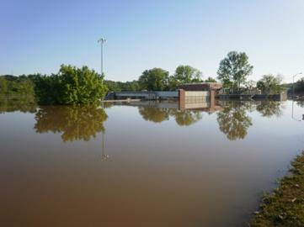
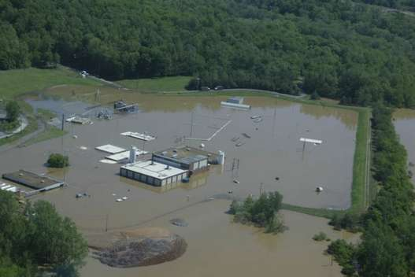
Clarksville, Tennessee Flood
Major surface water quality and public health impacts;
Environmental Impacts; Infrastructure; Operations

Slide 29
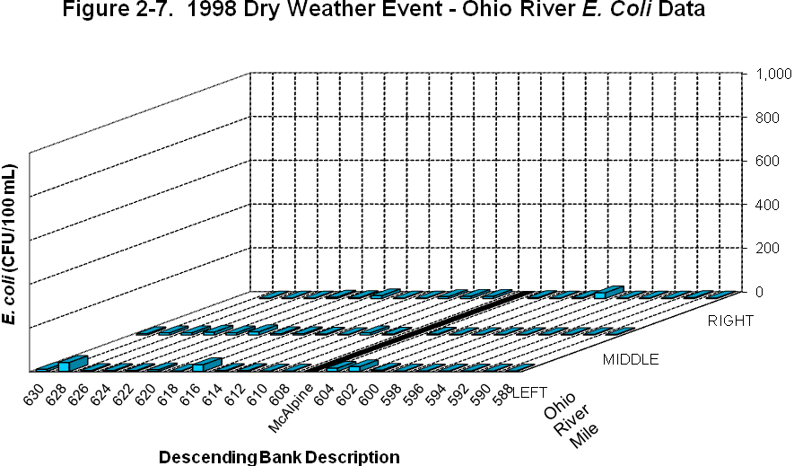
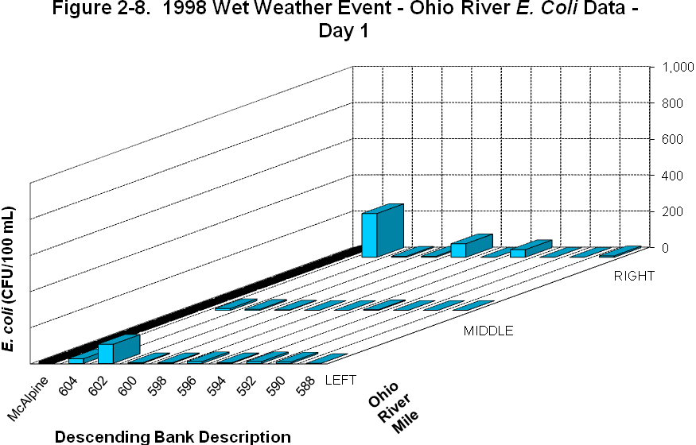
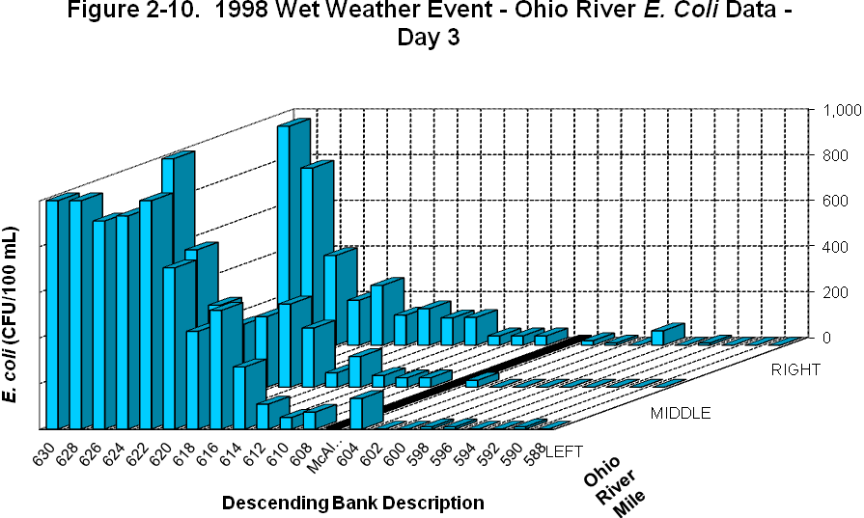
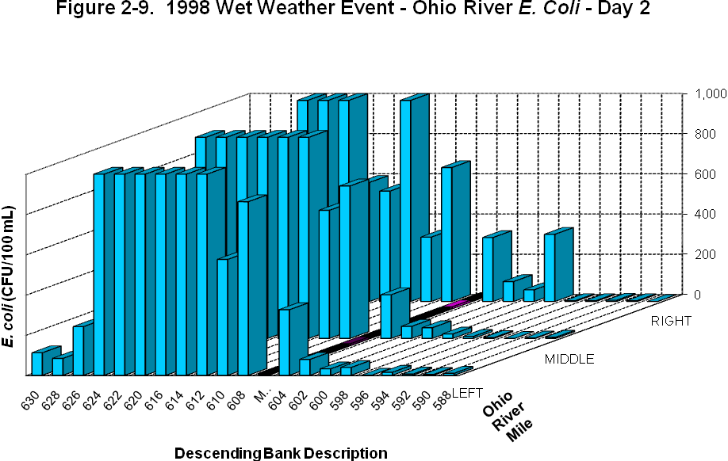
ORSANCO: Microbial Loading to Ohio River During Wet Weather and CSOs

Slide 30
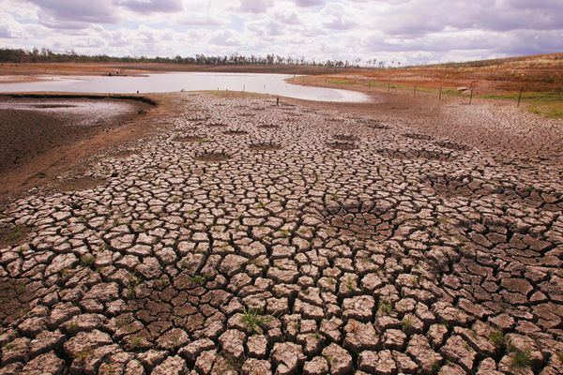
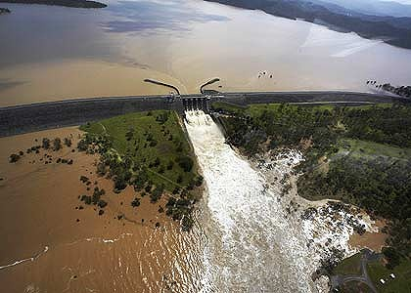
Sydney Water: Microbial Impacts of Drought followed by Flood
5 Years of Drought → Massive Flooding
Buildup of fecal matter in catchment
Flooding inundated system with crypto and giardia
3 Boil Water Alerts issued for customers
$13.1 M estimated for event
  $3.4 M for government inquiry
  $5.9 M for class action lawsuit administration

Slide 31
Anticipated Future Weather Challenges
Storms, Lightning
Top 5
Relevant to Ohio
Source: WaterRF 4324: Water Quality Impacts Of Extreme Weather-Related Events

Slide 32
Anticipated Weather-related Impacts
Maximize use of existing infrastructure
coupled with intelligent planning
Source: WaterRF 4324: Water Quality Impacts Of Extreme Weather-Related Events

Slide 33
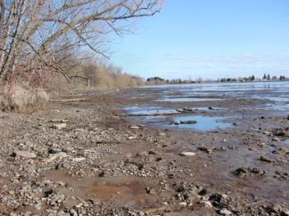
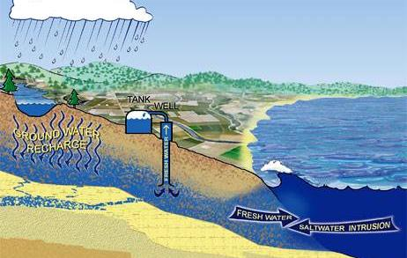
Source Water Quality Impacts
Severe Drought
With higher temp. cause excess evapotransporation
Concentrate contaminants in raw drinking water supplies
Amplify effects of WW effluent
Groundwater affected by long-term trends
  Potential salt water intrusion
  Chemistry sensitivity

Slide 34
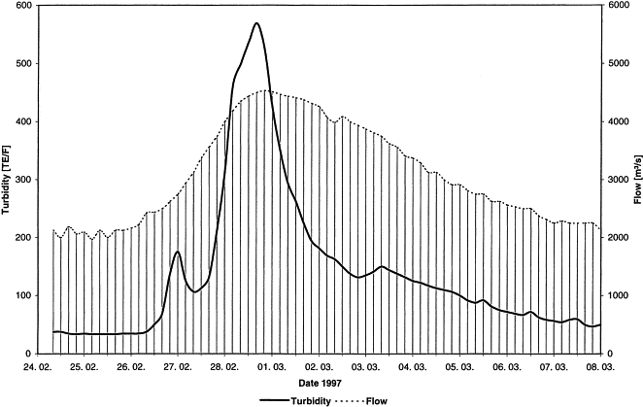
Heavy Rain Impacts
Heavy rains of substantial duration (hurricanes)
  Increased turbidity in rivers & tributaries
  Flush of constituents – duration variable
  Rain water impacts on pH and alkalinity

Slide 35
Tools for Adaptation and Planning: WaterQIEWE Tool – WaterRF 4324
Water
Quality
Impacts from
Extreme
Weather
Events
Database of case studies and data results from project to assist utilities and support agencies in preparing for and adapting to the impacts associated with extreme weather-related events
Notes:
Subsequent to the data collection process, we will analyze the data categorizing it for use with a database program. The challenge will rest upon how best to organize and demonstrate the interrelationships, commonalities, and interdependencies, among extreme weather-related events. For example, it may become evident that the data and case studies would best be grouped by the types of impacts (e.g., group by all events related to changes in disinfection byproducts in the distribution system); on the other hand, it may become apparent that the type of event or perhaps the geographic location of the event has more importance in linking the impacts between extreme weather and water quality and infrastructure.
Once completed we will roll out the tool in a second set of webinars for our utility participants in order to walk them through the use of the tool and kick off their review period, prior to finalizing the tool.
Subsequent to this we will draft a report and guidance document describing the methodologies used and additional information on use of the database.

Slide 36
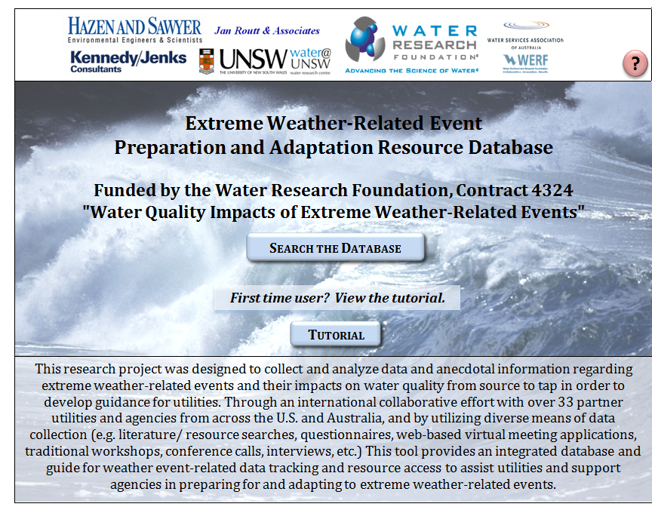

Slide 37
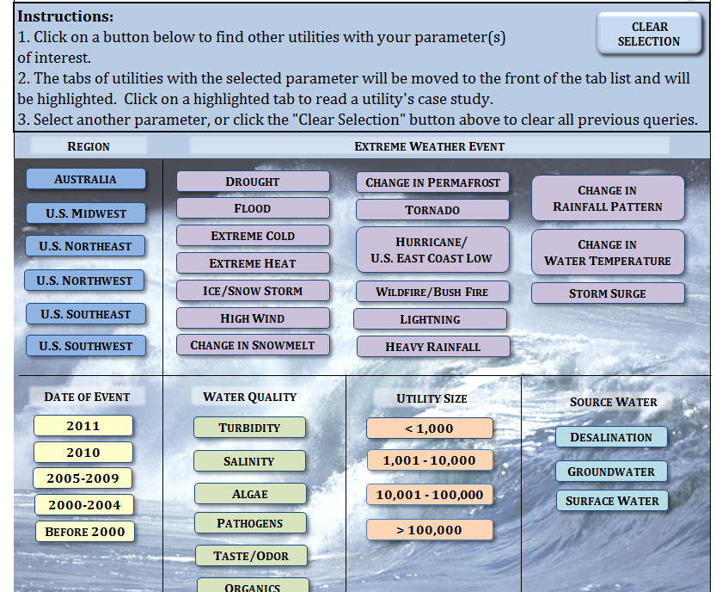

Slide 38
Preliminary Weather-Water Quality Data: Not Representative of Entire Database
✓
✓
✓
✓
✓
✓
✓
✓
✓
✓
✓
✓
✓
✓
✓
✓
✓
✓

Slide 39
How can the project findings be used?
Master planning
Emergency preparedness/future design improvements
Tabletop exercises
Emergency response plans

Slide 40
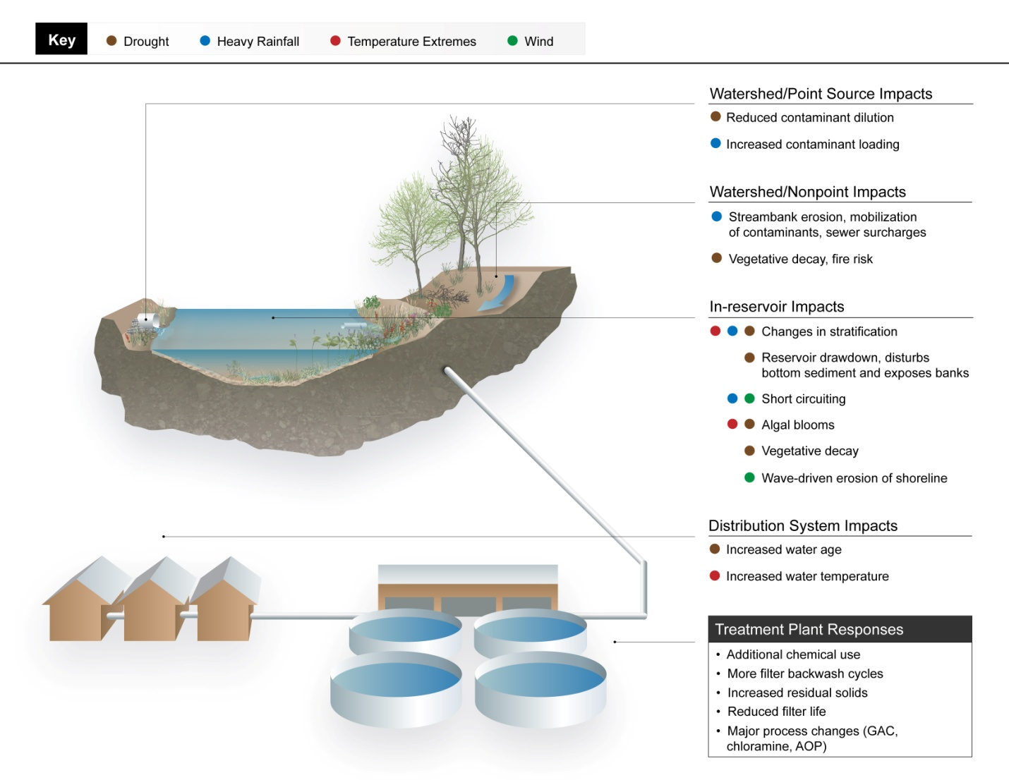

Slide 41
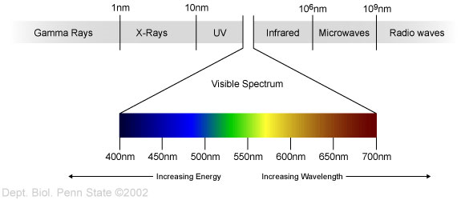
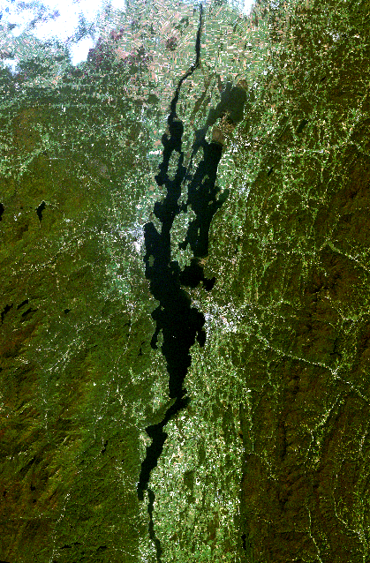
Tools for Adaptation and Planning: Advanced Remote Sensors/ Monitoring (Research Data from Umass Amherst)
Landsat 7 ETM+ visible bands:
  Band 1 = 450 – 515 nm (Blue)
  Band 2 = 525 – 605 nm (Green)
  Band 3 = 630 – 690 nm (Red)
Monitor chlorophyll-a and cyanobacteria blooms
Study lake dynamics
Landsat Image of Lake Champlain

Slide 42
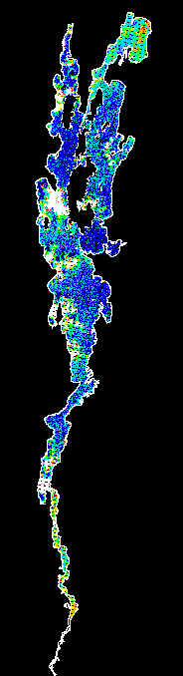
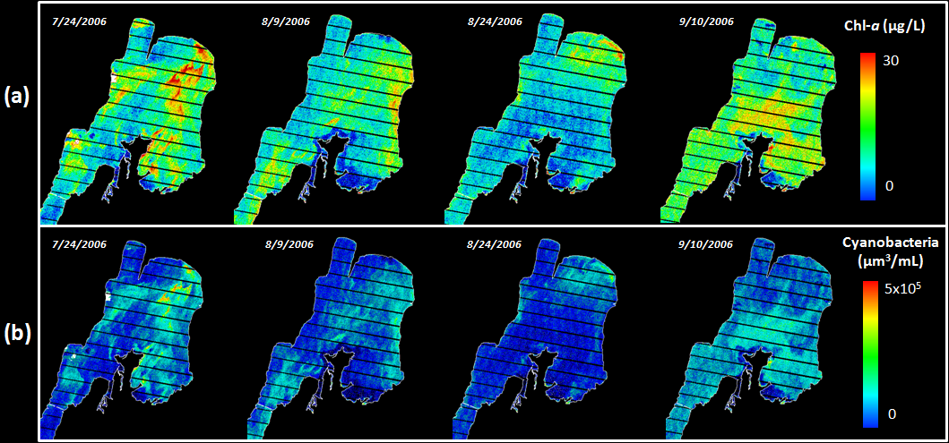
Band Ratio Model Results
Landsat 7 ETM+

Slide 43
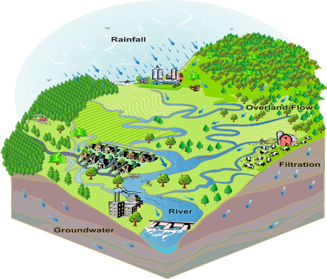

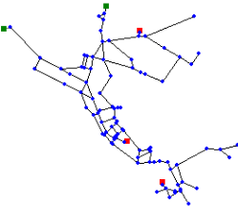
Some Summary Findings
Distribution
Water quality degradation
(typ. Loss of residual and DBP formation)
Treatment
Most plants can handle the increased pollutant load, but it is expensive
Raw Water Supply
Increase in contaminants
(typ. microbial and NOM)
Infrastructure
Power loss is the most common vulnerability
Notes:
Currently we’re finalizing the case studies with our utility partners
Raw – other known contaminants in the watershed could also be an issue, but organic matter and pathogens including turbidity are most common. This problem comes from multiple types of event, drought can lead to buildup of organic matter in both the watershed and in the reservoir itself, heavy rains and flooding , winds can mix reservoirs bringing contaminants up from the bottom sediment, DBP formation increases with increasing temperature and can encourage biological growth , extreme cold can affect thermal stratification.
Treatment – in most cases so long as the treatment facilities remained functional they were able to maintain compliance, often maintaining stricter internal water quality goals. Unfortunately this comes at very high cost. Additional chemicals, flushing filters, increased solids handling, etc. were most common.
On the distribution side the main issue was degradation of water once leaving the plant. Most common was increased water age during water use restrictions that could potentially lead to the loss of residual disinfectant or increased DBPs. Higher water temperatures only made these issues worse.
With respect to infrastructure facilities (raw water, treatment, and distribution) are most vulnerable to power loss. It should be noted that for facilities that do not have full backup power it is especially important to be sure that all mechanical equipment fail in a safe mode, preventing open valves from causing damage or flooding buildings. Direct damage was also an issue, but less so than power loss.

Slide 44
What does this mean?
General drought conditions
  Gradual impact on source water quality
  Pathogens and DBPs affected
Substantial rain events
  Rapid impact on water quality
  “Recovery” slower than initial impacts
Changes in reservoirs
  Total water volume / coverage area
  Intake location relevant to surface
  Changes in nutrients, algae, etc.
Changes in rivers
  Flow, turbidity, chemistry, runoff patterns
Don’t forget about groundwater impacts

Slide 45
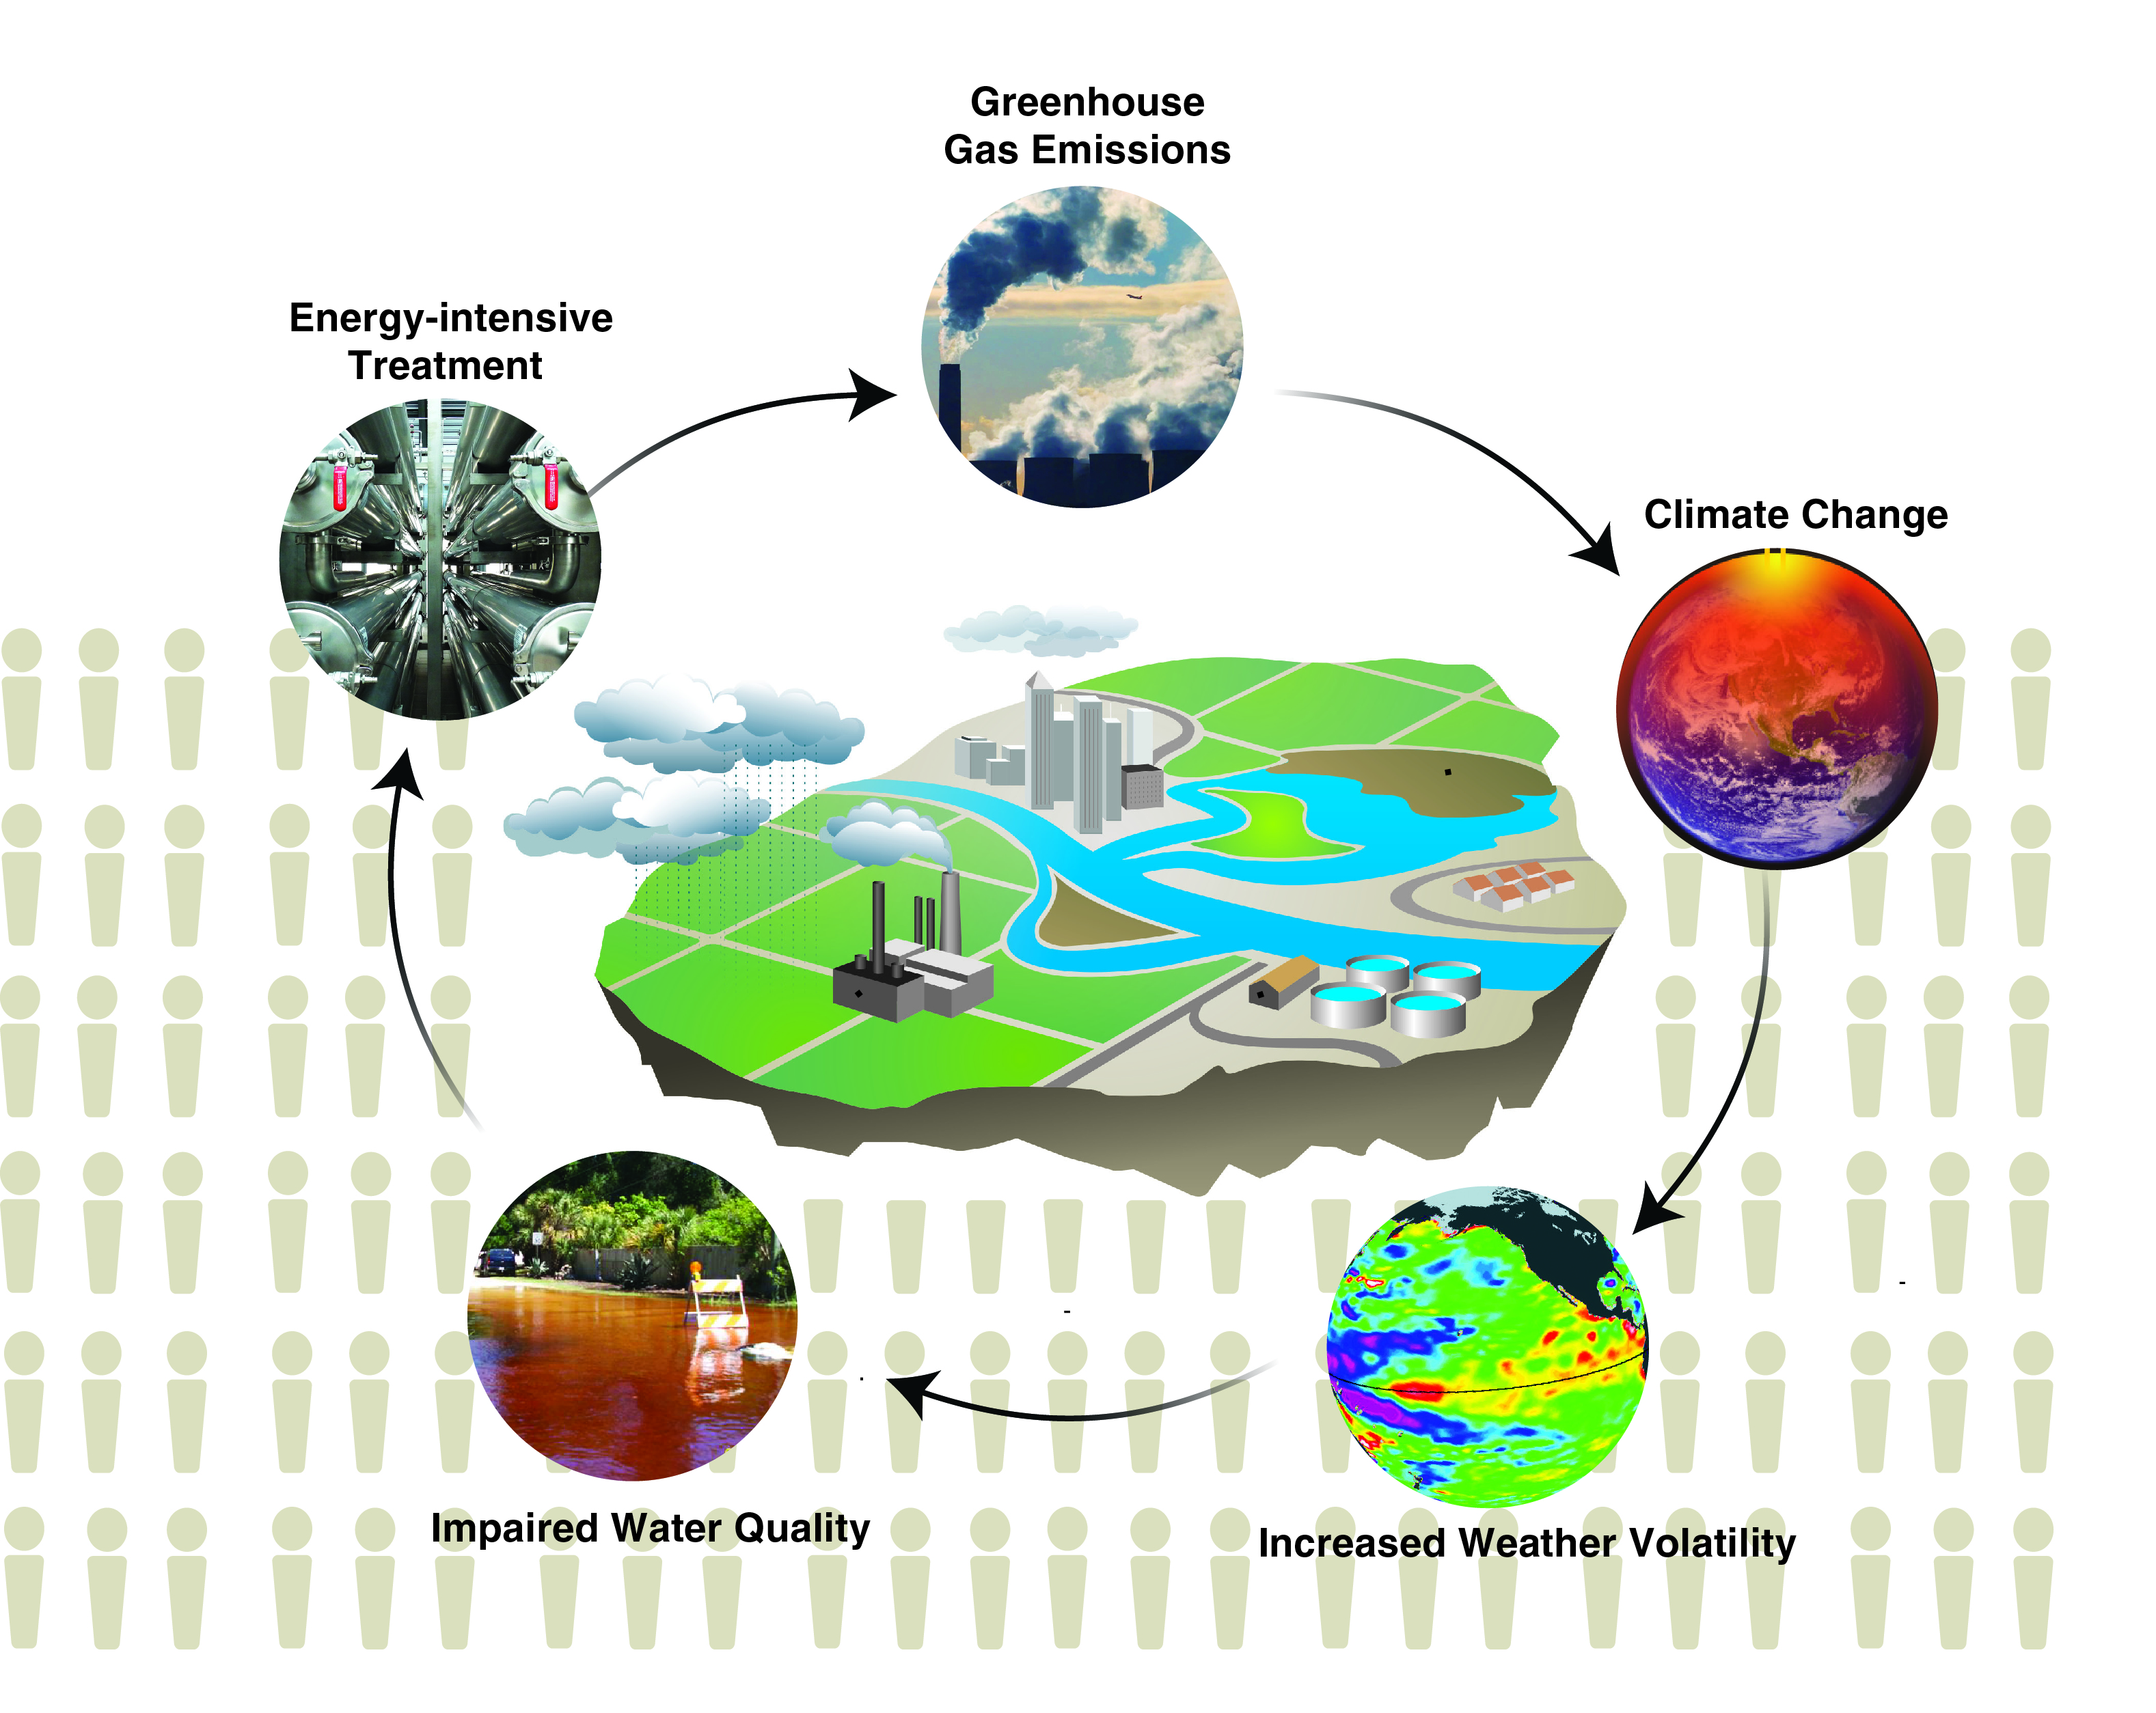
Water Resource & WQ Solution Cycle

Slide 46
Questions?

